Slide 1
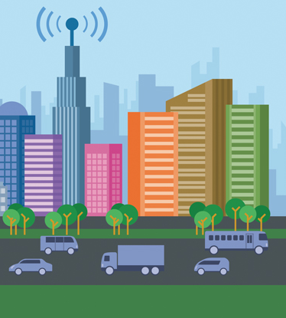
DETECTING ANOMALIES IN MUNICIPAL EXPENDITURES

Slide 2

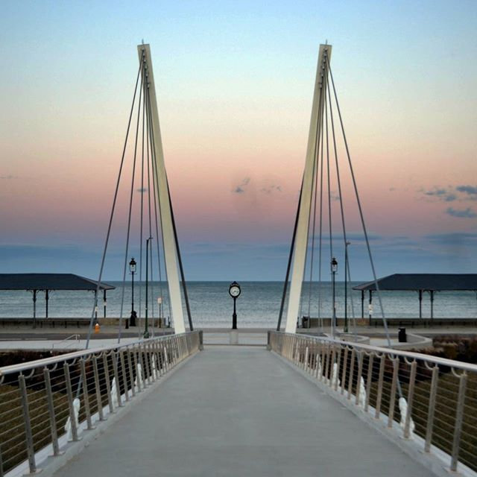
Hello!
Nice to meet you
Contact me at:
Michelle.ann.cheung@gmail.com
https://github.com/MichelleACheung

Slide 3
A Better Chance of Improving
2017 Fiscal Year Data
Large Accounts
Findings
Municipalities of any size can make data-backed decisions that reduce crime, lower traffic congestion and improve the environment, among other upgrades. Additionally, governments can determine how to spend money in more intelligent ways.

Slide 4

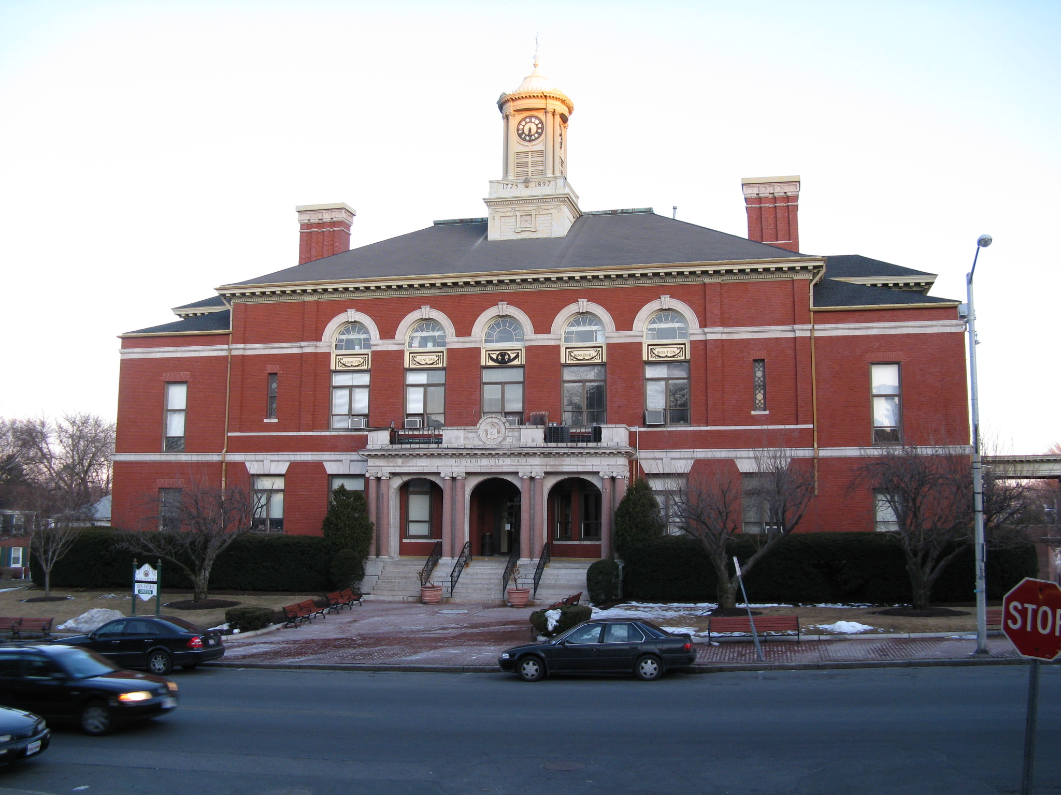
1.
2017 Fiscal Year Data
July 1, 2016 thru
June 30, 2017

Slide 5
2017 Fiscal Year Data
$ 2,936,726,263 Cash Flow
628
Different Accounts
54,000 (2017)
Population

Slide 6
2017 Fiscal Year Data: Expenditures
$ 300,055,282 Dollar Amount of Expenses
30,892
Expenses
266
Different Expenditure Objects/Categories

Slide 7
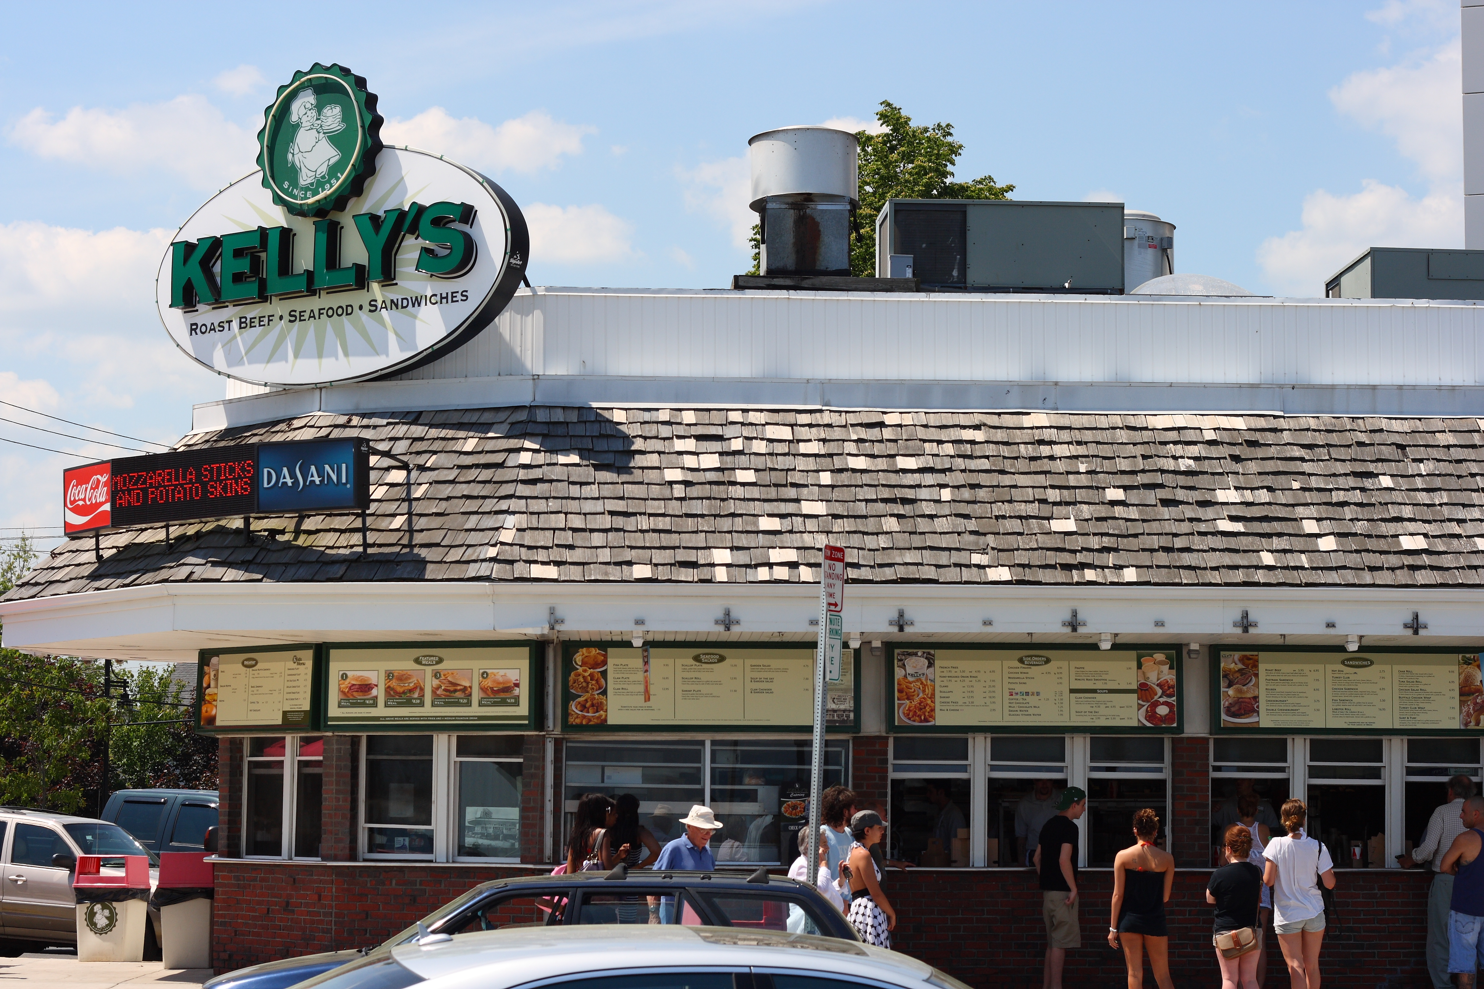
2.
Large Accounts
Accounts with at least 500 expenditures

Slide 8
Large Accounts
CLASSROOM
TEACHERS
SPED
OUTSIDE
TRANSPORTATION
PERMANENT
SALARIES
ASSISTANT
PRINCIPALS
INSTRUCTIONAL
MATERIALS
ADDITIONAL
DIFFERENTIAL
ATHLETIC
SUPPLIES & MATS
TUITION
TO
NON PUBLIC
SCHOOLS
BUILDING
SECRETARIES
PRINCIPALS
TUITION
TO
MASS SCHOOLS
BUILDING
MAINTENANCE
& REPAIR
EDUCATIONAL
INCENTIVE
OFFICE SUPPLIES
TAX TITLE

Slide 9
Large Accounts: Anomalies Detected
CLASSROOM
TEACHERS
SPED
OUTSIDE
TRANSPORTATION
PERMANENT
SALARIES
ASSISTANT
PRINCIPALS
INSTRUCTIONAL
MATERIALS
ADDITIONAL
DIFFERENTIAL
ATHLETIC
SUPPLIES & MATS
TUITION
TO
NON PUBLIC
SCHOOLS
BUILDING
SECRETARIES
PRINCIPALS
TUITION
TO
MASS SCHOOLS
BUILDING
MAINTENANCE
& REPAIR
EDUCATIONAL
INCENTIVE
OFFICE SUPPLIES
TAX TITLE

Slide 10
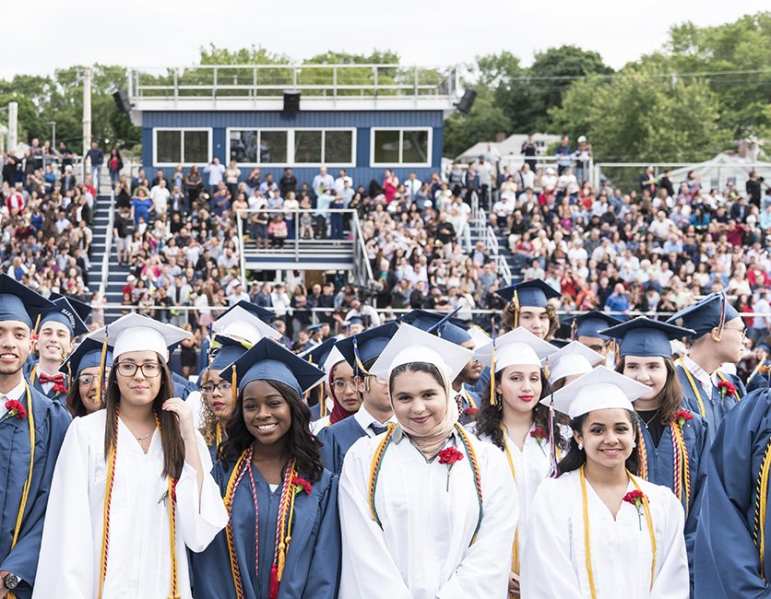
3.
Findings
Summary of Anomalies in Expenditures

Slide 11
Classroom Teachers
Total of:
43 anomalies out of
674 expenditures
Amount of Transactions | 50th Percentile Amount | Amount of Anomalies | Average Amount
135 | $33,925 | 3 | $361,511
177 | $45,738 | 4 | $447,703
140 | $52,029 | 35 | $5,842
90 | $7,328 | 1 | $72,538

Slide 12
Additional Differential
Total of:
79 anomalies out of
324 expenditures
Amount of Transactions | 50th Percentile Amount | Amount of Anomalies | Average Amount
245 | $39 | 79 | $3,452

Slide 13
Office Supplies
Total of:
11 anomalies out of
164 expenditures
Amount of Transactions | 50th Percentile Amount | Amount of Anomalies | Average Amount
153 | $600 | 11 | $58

Slide 14
Tuition to Non Public Schools
Total of:
13 anomalies out of
461 expenditures
Amount of Transactions | 50th Percentile Amount | Amount of Anomalies | Average Amount
89 | $5,455 | 3 | $520
104 | $6466 | 2 | $354
104 | $7,565 | 1 | $77
92 | $8,609 | 5 | $544
59 | $9,413 | 2 | $504

Slide 15
Tax Title
Total of:
1 anomalies out of
369 expenditures
Amount of Transactions | 50th Percentile Amount | Amount of Anomalies | Average Amount
368 | $75 | 1 | $750

Slide 16
Building Secretaries
Total of:
65 anomalies out of
380 expenditures
Amount of Transactions | 50th Percentile Amount | Amount of Anomalies | Average Amount
262 | $868 | 64 | $813

Slide 17
Athletic Supplies & Mats
Total of:
3 anomalies out of
351 expenditures
Amount of Transactions | 50th Percentile Amount | Amount of Anomalies | Average Amount
89 | $58 | 1 | $5,934
62 | $75 | 1 | $7,249
197 | $80 | 1 | $8,334

Slide 18
Tuition to Mass Schools
Total of:
1 anomalies out of
94 expenditures
Amount of Transactions | 50th Percentile Amount | Amount of Anomalies | Average Amount
93 | $5,571 | 1 | $565

Slide 19
SPED Outside Transportation
Total of:
13 anomalies out of
273 expenditures
Amount of Transactions | 50th Percentile Amount | Amount of Anomalies | Average Amount
157 | $2,500 | 10 | $250
103 | $3,318 | 3 | $326

Slide 20
Assistant Principals
Total of:
10 anomalies out of
328 expenditures
Amount of Transactions | 50th Percentile Amount | Amount of Anomalies | Average Amount
318 | $2,031 | 10 | $2,260

Slide 21
$29,724,067
Total Amount from Anomalies in Expenditures

Slide 22
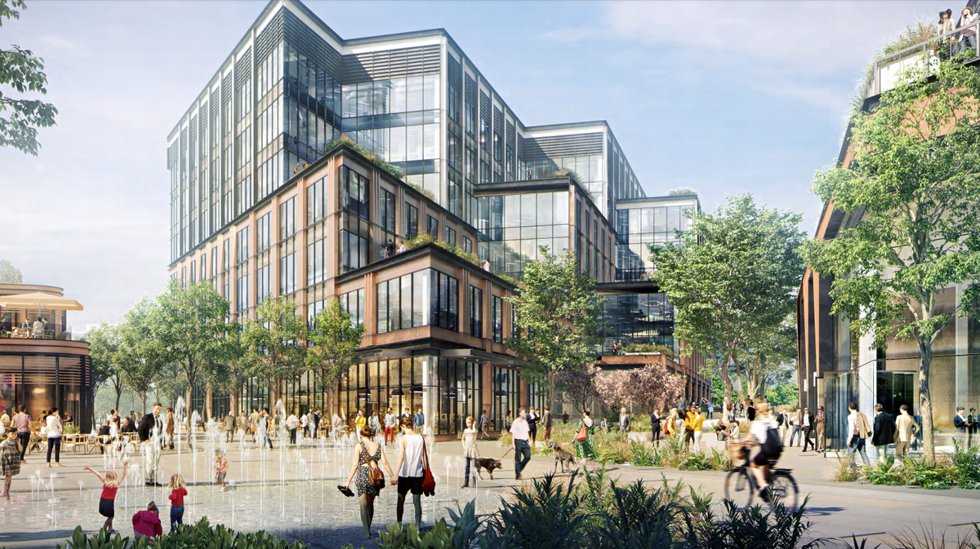
What can a city do with $30,000,000?

Slide 23

Thank you very much for your time
If you have any questions please don’t hesitate to contact me at:
Michelle.ann.cheung@gmail.com
https://github.com/MichelleACheung

